Slide 1
North Yorkshire Cycling
Identifying the Best Town for a New Bike Shop

Slide 2
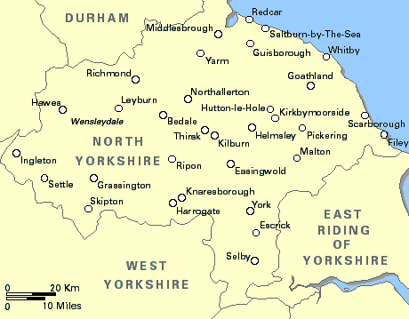
Introduction to North Yorkshire
Cycling in North Yorkshire is a hugely popular sport and attracts both locals and enthusiasts from all over the world.
Last September the World Championships were held in the spa town of Harrogate, whilst the county has previously hosted the prestigious Tour de France Grande Depart. The Tour de Yorkshire takes place every year and is one of the most loved events in the Yorkshire’s sporting calendar. With large events like this inspiring people to cycle there is a huge demand for bikes and cycling shops.

Slide 3

The problem?
I want to find the optimal location to place my bike shop. I want to choose a location that is not already saturated with shops, which has the opportunity to offer a new service.
However, I also want there to be sufficient demand and do not want to place a shop in a location where I shan’t be able to make any sales, even if there are currently no bike shops there.

Slide 4
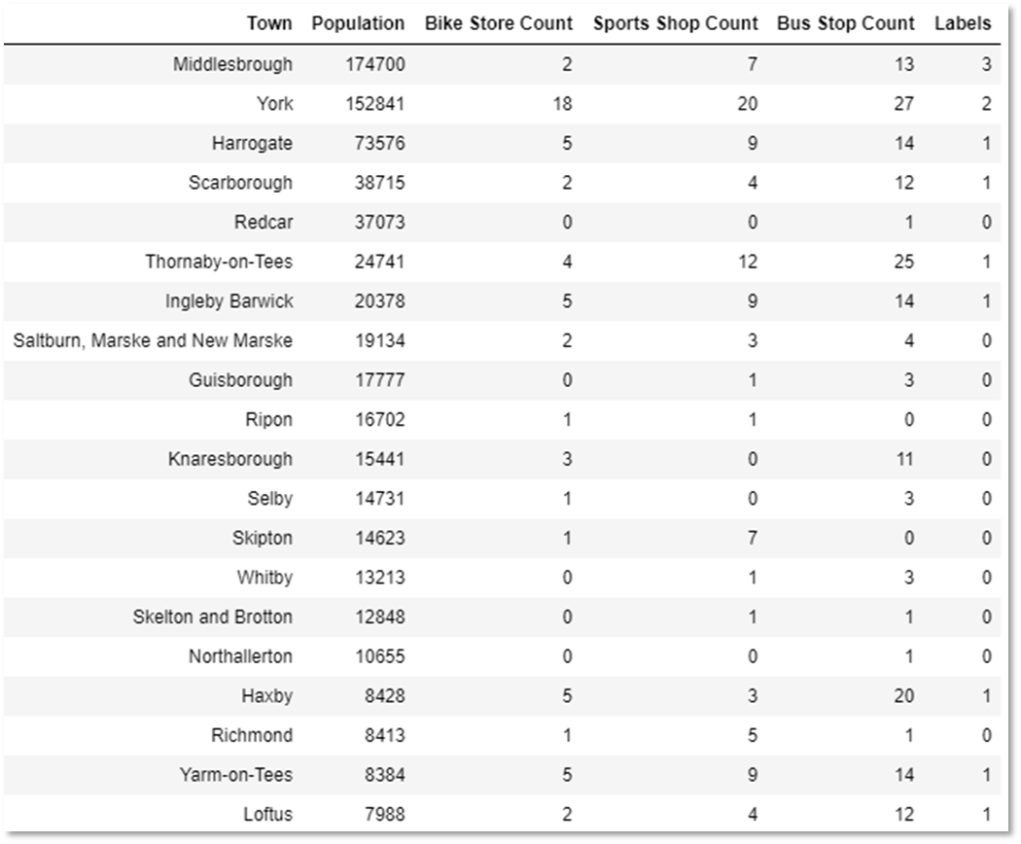
The towns of North Yorkshire were classified by k-means clustering:
For my investigation I used BeautfulSoup to scrape the towns and populations.
I then used OpenCage Geocoding API to obtain the Longitudes and Latitudes.
Foursquare API was then used to obtain the venue information.
I used k-means clustering to obtain a label for each town and to group them.

Slide 5
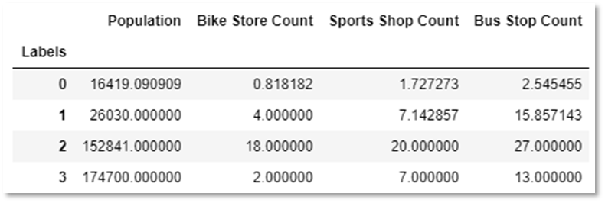
There are four well defined clusters:
0: Small Population: Few Bike Stores, Sports Shops and Bus Stops.
1: Small Population: Medium number of Bike Stores, Sports Shops and Bus Stops.
2: Large Population: Many Bike Stores, Sports Shops and Bus Stops.
3: Large population. Few Bike Stores, Sports Shops. Many Bus Stops
Cluster 3 presents the best opportunity for starting a new business
The above table shows the cluster label, and the average value for each of the variables I used in the clustering.

Slide 6
My recommendation is to use Middlesbrough as my location for a new bike shop.
To conclude I would choose Middlesbrough (which belongs to cluster 3) as my destination of choice for the new bike shop. It is clear from the results that this town has the most potential for starting a new business. It is a large town that stands out from my investigation as currently having very little providers of bikes and services.
To improve my findings, I could expand the number of venues I retrieved from the foursquare API. I also think that if I were to apply my investigation over a larger area, I would also find more suitable towns to start a business in. For example, there may be a town just over the border in another county that I have not considered which is actually geographically very close. This may also improve the accuracy of my k-means clustering as I would have a larger dataset to utilise.

